Slide 1

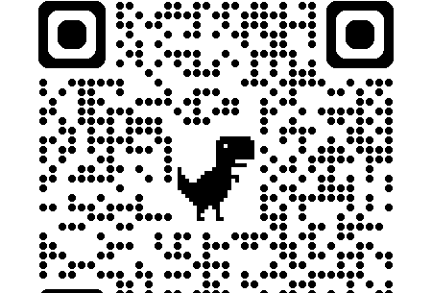


CMNS 3500 - Language and Power: Clarity, Accessibility and Persuasion in Health Messaging

Slide 2

Territorial Acknowledgement

Slide 3
Where we’re going today
Controversial Health Claims: Modality and Passives
01
Assessing the
Un-Essay
02
Project Work (as time permits)
03

Slide 4
Nov 19 | Controversial Claims II: Grammar of misinformation—modality, passives, nominalization Submit Grading Template for Unessay
Nov 26 | Social Media and the language of health: Clickbait, metaphor, sensationalism. Submit Unessay (30%)
Dec 3 | Final In-class task (15%): Designing ethical health communication: Navigating misinformation, accessibility, and trust
The Final Countdown

Slide 5
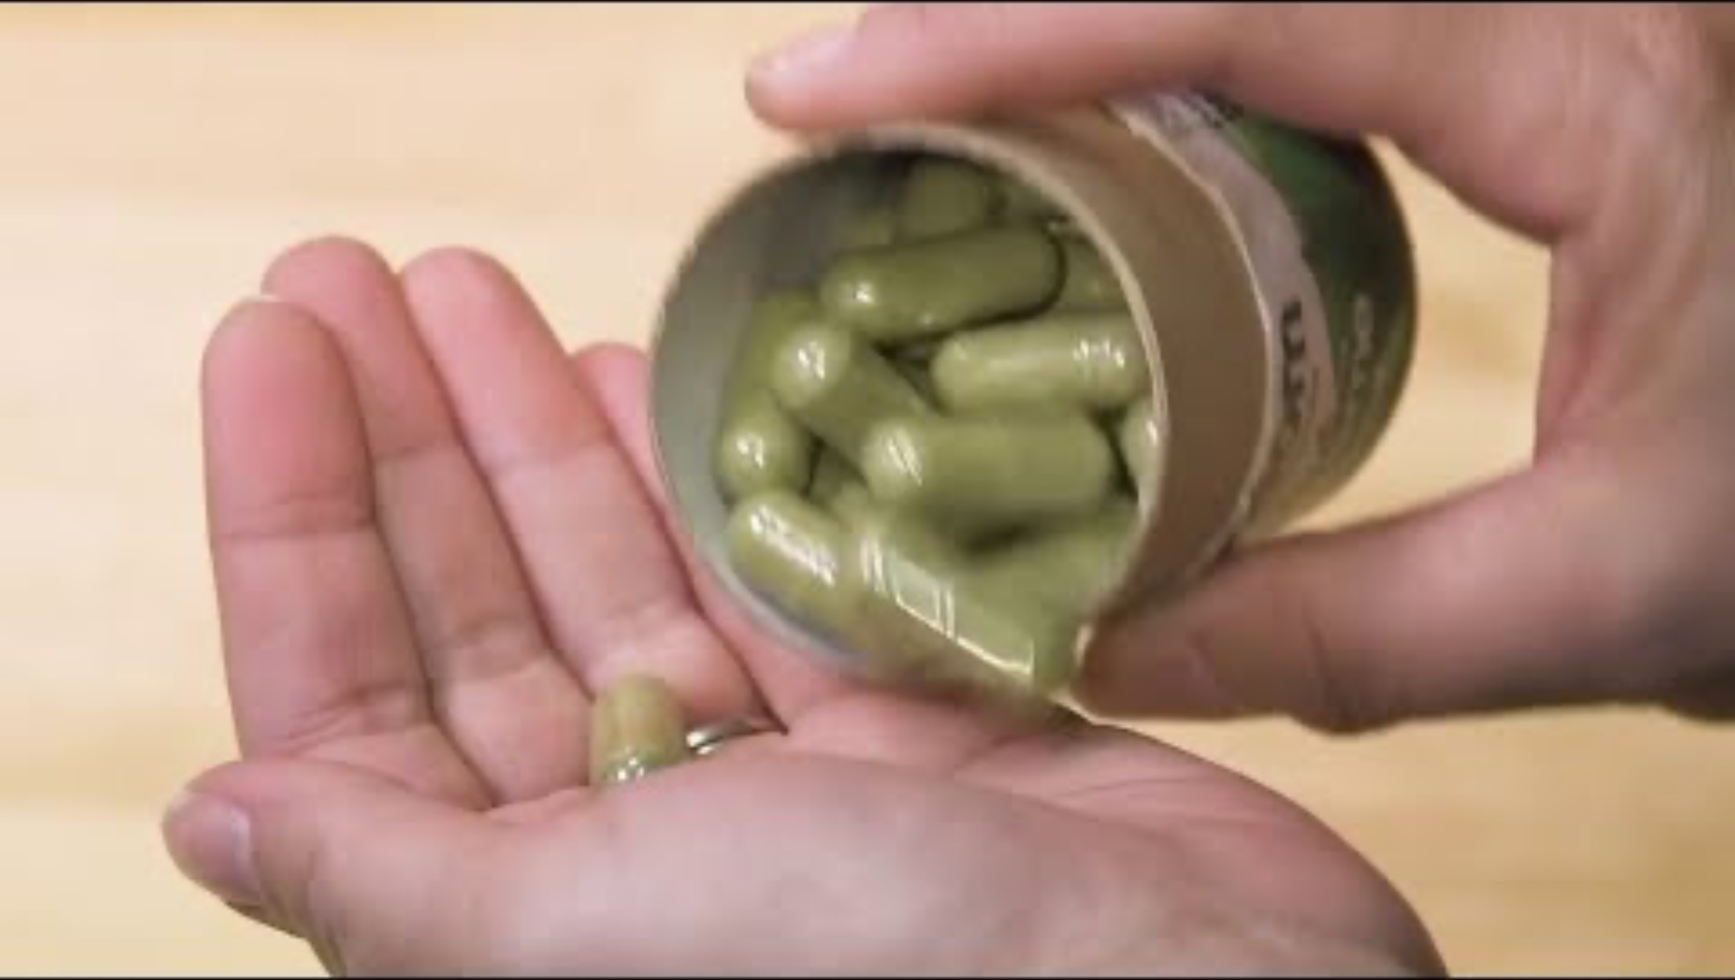

Slide 6
Review on Modality
Interpersonal metafunction
How we express certainty, possibility, necessity, or permission in language
A spectrum from absolute certainty to pure speculation
Can inform, persuade, or mislead

Slide 7
Certainty and Modality
High Certainty: "Smoking causes lung cancer"
Moderate Certainty: "This may help reduce inflammation"
Low Certainty: "Some believe there could be a connection"
Obligation: "You should consult your doctor"
Permission: "You can take this with food"

Slide 8

Why should we care?
The way claims are phrased affects how people perceive risk and benefit
Strong language creates confidence; weak language creates doubt
Mismatched modality between evidence and claims can mislead consumers
Healthcare decisions can have life-or-death consequences

Slide 9
Manipulation Tactic 1
False Certainty
Presenting speculation as established fact
Example: "This will cure your arthritis"
Example: "Toxins are making you sick"
Used to sell unproven treatments by appearing authoritative

Slide 10
Manipulation Tactic 2
Strategic Hedging
Example: "This product may support immune health"
Legally defensible but scientifically meaningless
Creates impression of benefit without making testable claims

Slide 11
Manipulation Tactic 3
Just Asking Questions
Using questions to plant doubt without making direct claims
Example: "Could vaccines be causing autism?"
Example: "What if doctors are hiding the cure?"
Implies possibility where evidence shows none exists

Slide 12
Active Voice: | Passive Voice:
Researchers found that vitamin C prevents colds. | It was found that vitamin C prevents colds.
The FDA rejected the cancer drug application. | The cancer drug application was rejected.
Dr. Smith conducted the study. | The study was conducted.

Slide 13
Legitimate Uses of Passive Voice
Scientific convention: Research papers emphasize findings over researchers.
Example: The compound was isolated and tested.
Unknown mechanisms: When we don't fully understand how something works.
Example: Inflammation is reduced by this pathway.
Emphasizing the subject: Focus on what matters to readers.
Example: Patients were treated successfully.

Slide 14
Red Flag #1 - The Vague Authority Claim
“It has been shown that alkaline water cures cancer”
Problems: Who showed this? When? Where was it published? What were the study parameters?
Why it works: Creates illusion of scientific consensus without verifiable sources
Reality check: Ask for specific studies, authors, and publication details

Slide 15
Red Flag #2 - The Responsibility Dodge Claim
“Mistakes were made in the clinical trial.”
Problems: Who made them? Were they negligent? What specific mistakes occurred?
Why it works: Deflects accountability and makes investigation difficult
Reality check: Demand specific information about what happened and who was responsible

Slide 16
Red Flag #3 - The False Equivalence Claim
”Questions have been raised about vaccine safety.”
Problems: Who raised them? What are their credentials? What is the actual evidence?
Why it works: Gives fringe opinions equal weight with mainstream science
Reality check: Distinguish between legitimate scientific debate and unfounded speculation

Slide 17


Slide 18
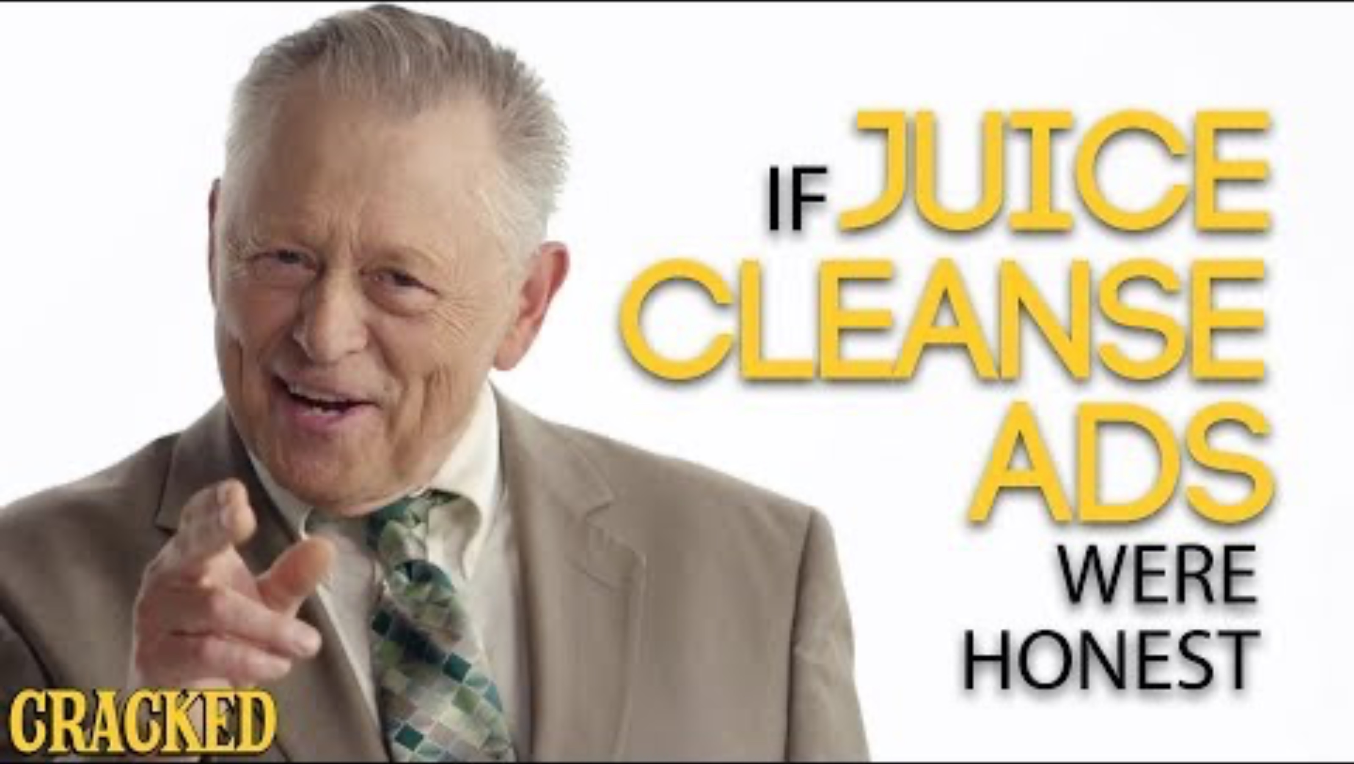

Slide 19
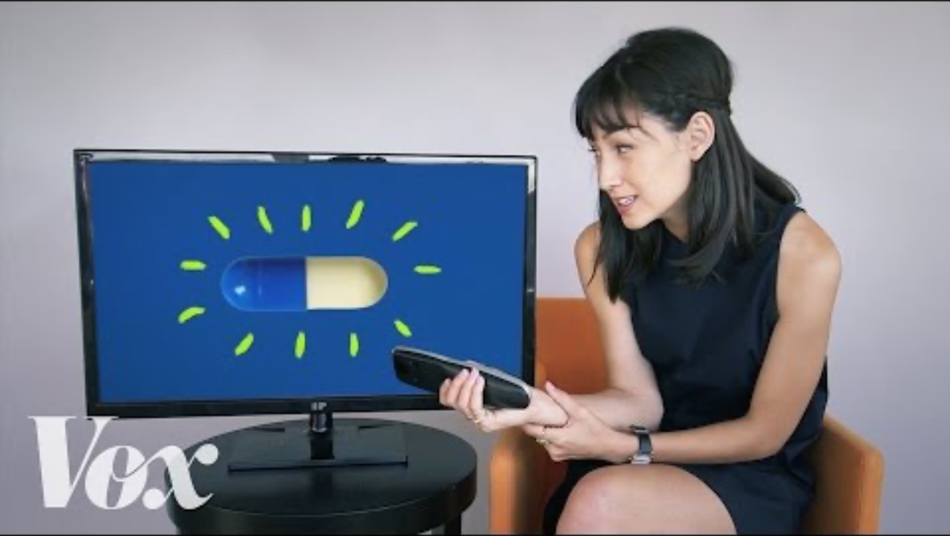

Slide 20


Slide 21
