Slide 1

CMNS 3500
Power and Language
September 22, 2026

Slide 2

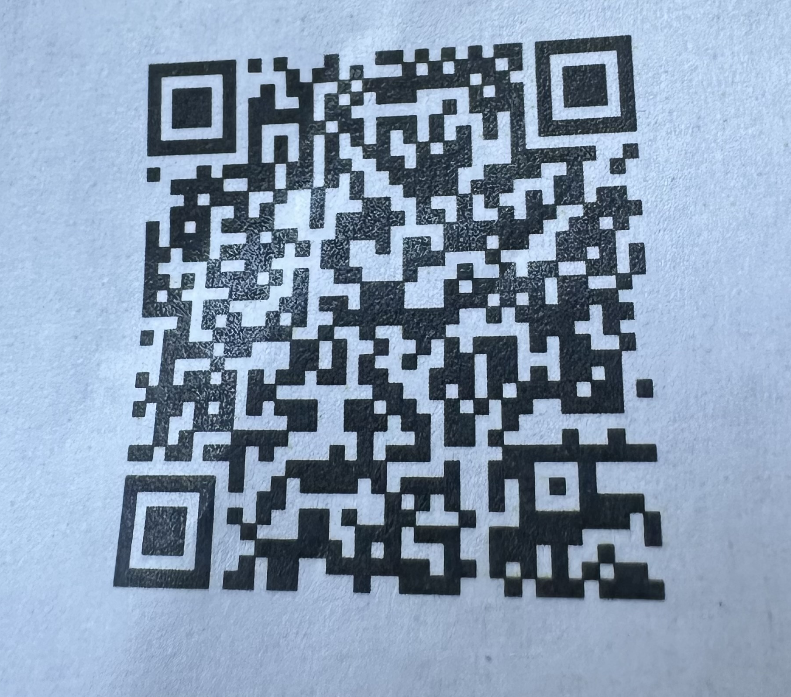
News and events
September 23, 2:00 to 2:45 – Yoga for Self-Regulation (Room 1522 Old Main
September 24 noon – TRUSU Community Meal
September 24 evening – TRUSU Outdoor Movie Night and Food Truck Festival (movie is Michael)
September 24, 6:00 Speed Friending Event (Room 1501 Old Main)
September 25 – Canadian Assoc of Journalists Panel
September 29 – Open Mic Night, TRUSU Lecture Hall

Slide 3

Territorial Acknowledgement

Slide 4
Where we’re going today…
Review of SFL and the Ideational Metafunction
Application to Díaz and Wadhwa article
The Interpersonal Metafunction

Slide 5


Slide 6
The Ideational Metafunction
Language as a tool to construe reality
Answers the question: “What’s happening?”
We look at:
  Actor
    Actor, Senser, Carrier, Sayer, etc.
  Goal
    Recipient of Process
  Circumstances
    Time, place, manner, cause, accompaniment
    and..

Slide 7
Processes
Process Type | Description | Example
Material | Physical actions/events | "She built a house."
Mental | Thoughts, feelings, perceptions | "He fears rejection."
Relational | States, identity, attributes | "The sky is blue."
Behavioral | Physiological/psychological acts | "She laughed."
Verbal | Communication | "They shouted."
Existential | Existence | "There is a problem."

Slide 8
Understanding Research Article Structure
In the next ten minutes, outline the article’s main and sub- sections on the paper provided.
Email a photo of your outline to cadam@tru.ca

Slide 9

How does an analysis of the ideational (experiential) metafunction serve your understanding of power as expressed in textbooks?

Slide 10

The Interpersonal Metafunction
Mood: giving information, demanding it, offering something, or requesting something.
Modality: expressing certainty, obligation, or possibility (e.g., "must," "might," "should").
Appraisal: being positive, negative, neutral, or evaluative.
Pronouns and Formality: shaping the relationship between speaker and listener.

Slide 11

Why the Interpersonal Metafunction Matters
It helps us:
Express feelings and judgments “I believe this is unfair”
Negotiate power and solidarity “Could you help me?” vs. “Help me now.”
Build rapport or assert authority depends on the context

Slide 12

Listen and read the captions for the interpersonal metafunction in action

Slide 13
Preparing for next class
  Review revised assignment description for Project One
  Next class:
    Textual Metafunction
    Guidance on starting Project One

