Slide 1

CMNS 3500
Power and Language
2026.10.06

Slide 2

News and events
October 7, 2026 11:00 am - 12:30 pm
AE 101
Gender equality – norms, strategies, implementation
Angela Kolb-Jansen
Harz University of Applied Sciences in Germany
Every Monday 9:30-10:15 Every Wednesday 2:00-2:45
1522 Old Main
Yoga for Self Regulation

Slide 3
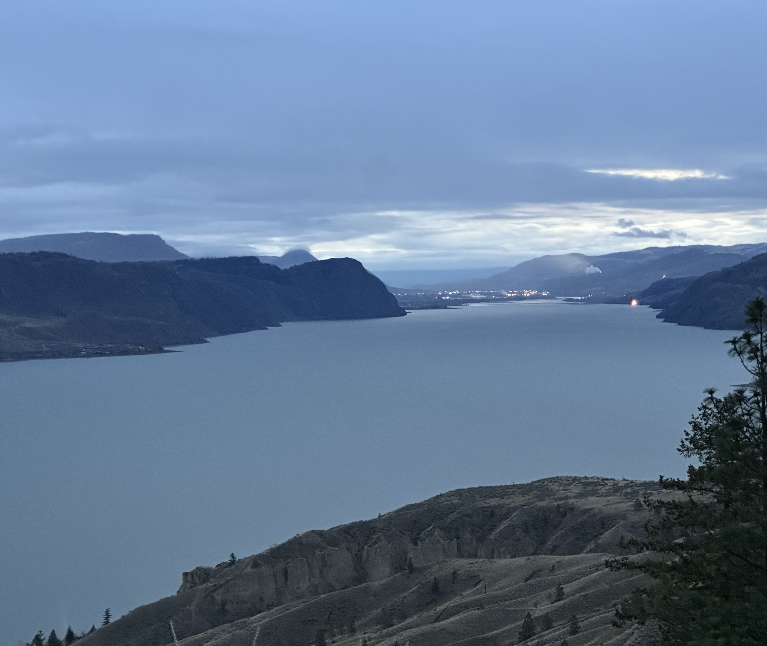
Territorial Acknowledgement

Slide 4
Where we’re going today…
Mindfulness
Feedback Literacy

Slide 5
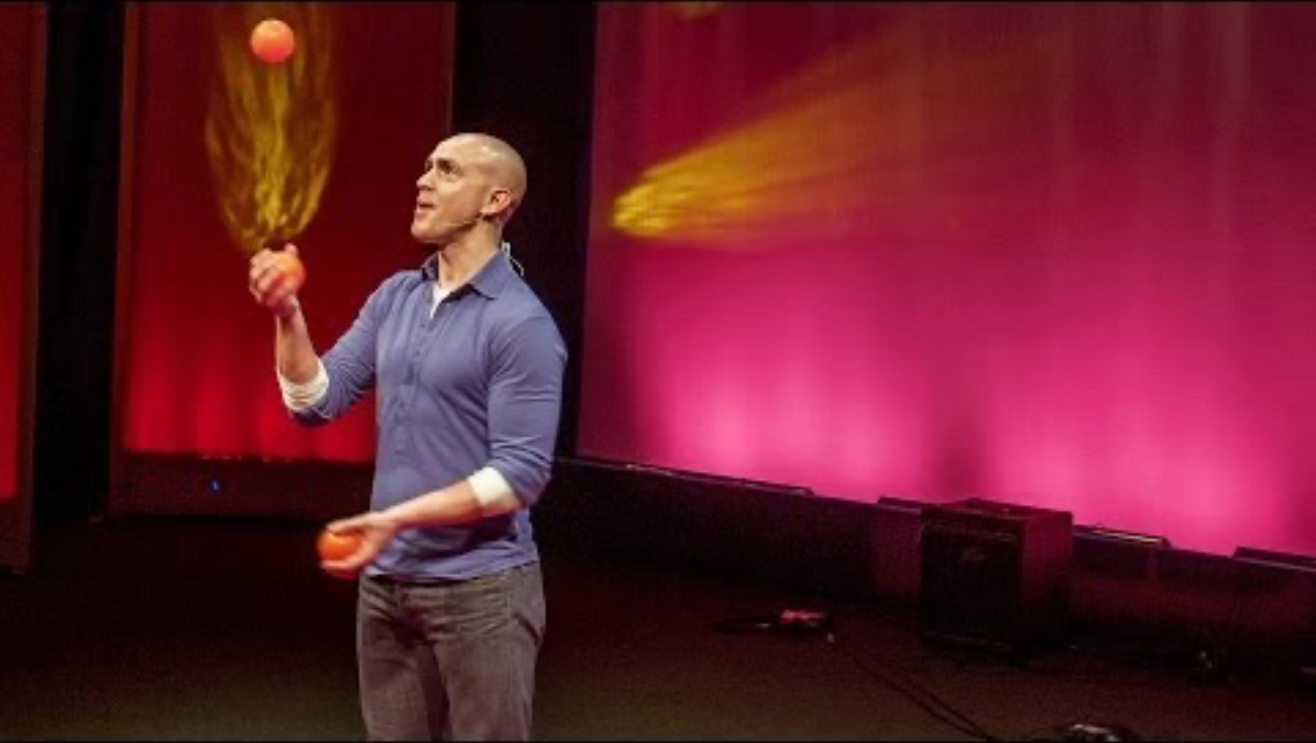

Slide 6
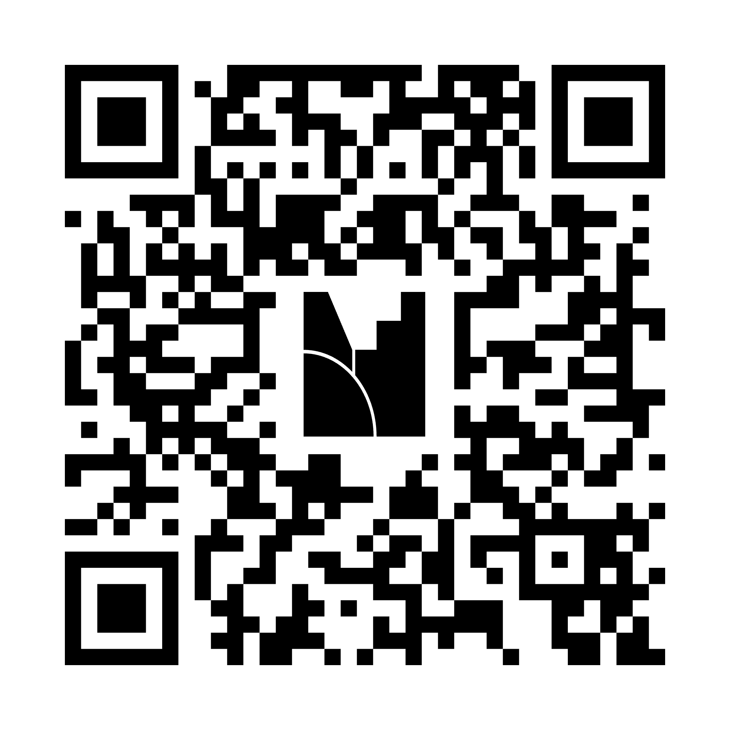
Selecting a voice for today’s guided meditation (CMNS 3500)
results

Slide 7

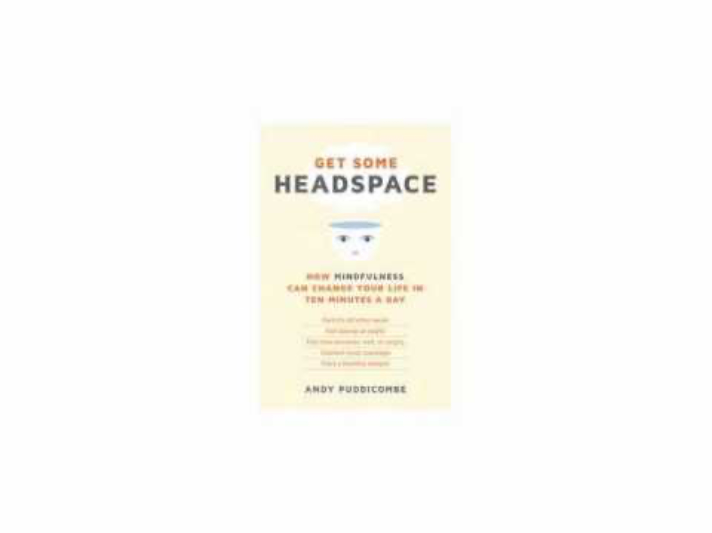
Guided meditation – feminine voice (start at 1:40 in)
Guided meditation – masculine voice
(start at :24 in)

Slide 8
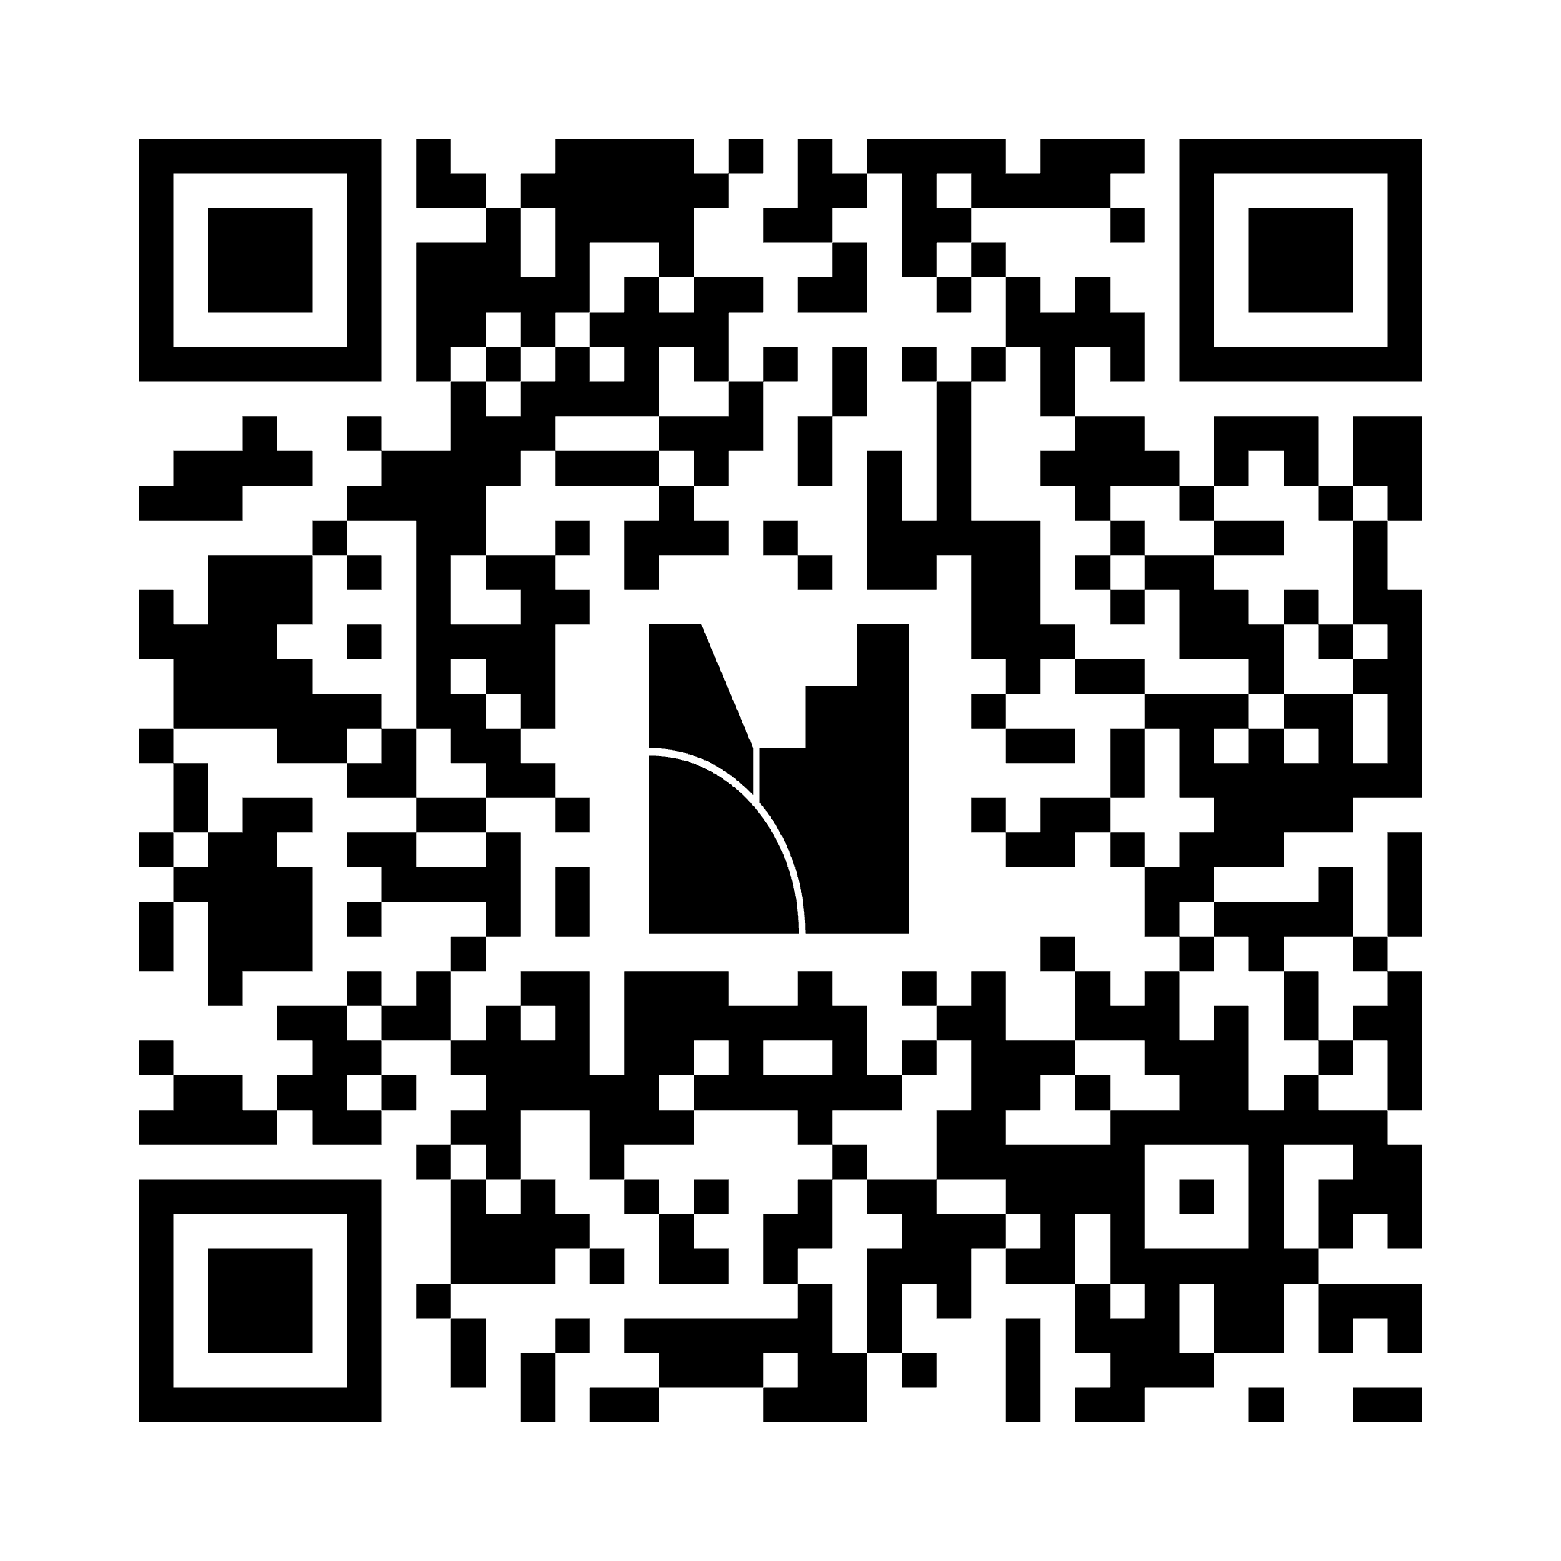
How are you feeling about receiving feedback?
results

Slide 9
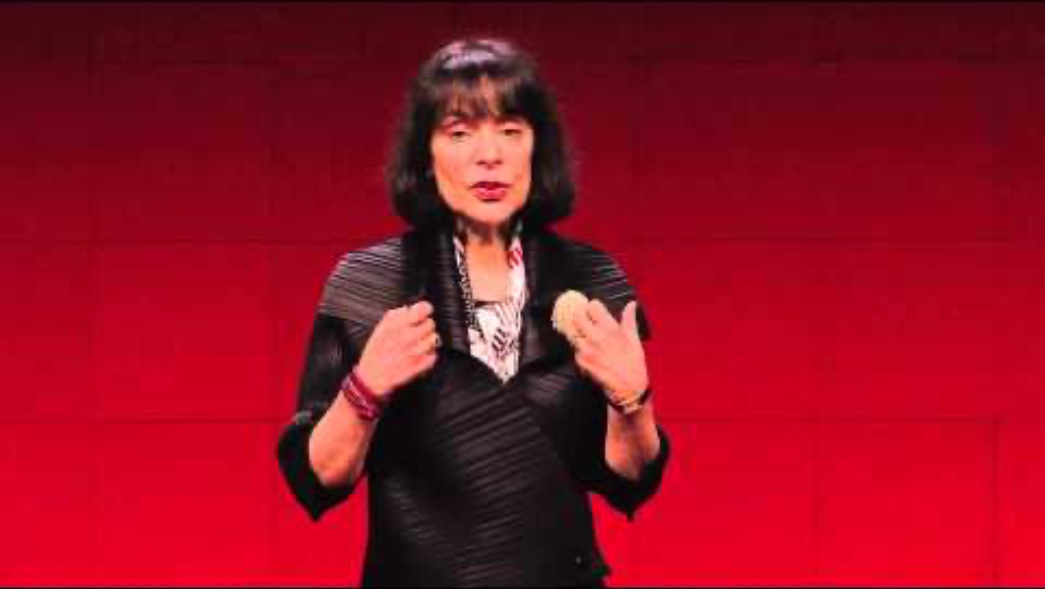

Slide 10
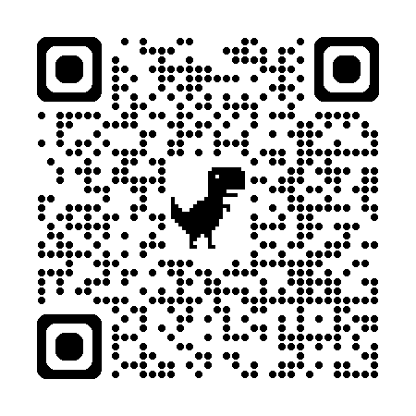
Chris’ Office Hours

Slide 11
Preparing for next class
  Follow the guidance on the Feedback Literacy site (see this week’s reading link) to prepare yourself to receive and respond to feedback.
  Look through my feedback on your assignment. Send me a quick email (cadam@tru.ca) TODAY to tell me one thing you will apply to your next draft or assignment in this course.
  Spend some time on the AI Guidelines draft (on this week’s readings link) – be prepared to speak about it.

